Slide 1
3.2 Rate Monotonic Analysis
Assumptions
  A1. No nonpreemptible parts in a task, and negligible preemption cost
  A2. Resource constraint on CPU time only
  A3. No precedence constraints among tasks
  A4. All tasks periodic
  A5. Relative deadline = period

Slide 2
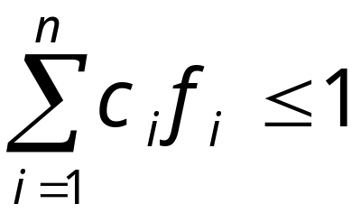
Rate-Monotonic Scheduling(RMS)
Overview
  rate monotonic priority
    the higher rate, the higher priority
  schedulability guaranteed if utilization rate is below a certain limit
  for feasible schedules
    f_{i} = 1/T_{i} : frequency (=rate)
    c_{i} or C_{i} : execution time

Slide 3
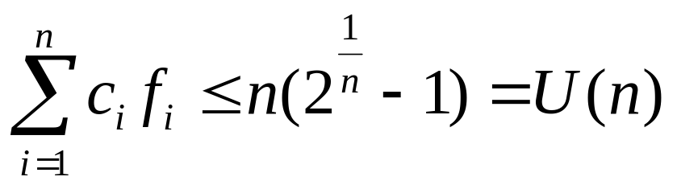
(continued)
  If the total utilization rate has least upper bound n(2^{1/n} - 1) where n = #tasks, there exists a feasible rate monotonic schedule. That is,
    U(1) = 1.0, U(2) = 0.828, U(3) = 0.779, U(∞) = ln2
    only sufficient condition
  priority inversion problem
    if a more critical task has a longer period

Slide 4
Rate Monotonic Analysis(RMA)
Basic theory with periodic tasks
Introduction
  Rate monotonic analysis(RMA)
    a method for analyzing sets of real-time tasks
    based on rate monotonic scheduling theory
    analytic formulas to determine schedulability
    framework for reasoning about system timing behavior
    separation of timing and functional concerns
    provides an engineering basis for designing real-time systems

Slide 5
(continued)
  Basic theory applies only to independent, periodic tasks, but has been extended to address:
    priority inversion
    task interactions
    aperiodic tasks
  Why are deadline missed?
    preemption
    execution
    blocking

Slide 6
A Sample Problem
Periodics
Servers
Aperiodics
100 msec
Emergency
50 msec
₁
20 msec
Data Server
5 msec
2 msec
150 msec
20 msec
Deadline 6 msec
after arrival
₂
40 msec
Comm Server
Routine
40 msec
10 msec
350 msec
10 msec
2 msec
₃
100 msec
Desired response
4 msec average
₂’s deadline is 20 msec before the end of each period

Slide 7
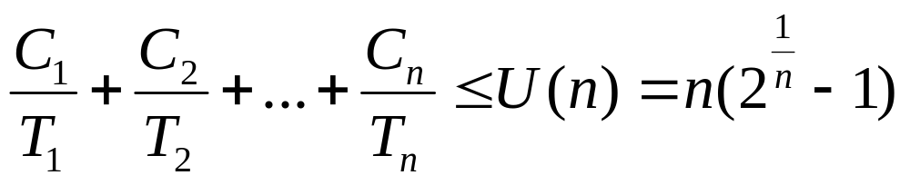
Periodic tasks
  task’s CPU utilization U_{i} = C_{i}/T_{i}
  total CPU utilization U = U_{i} + U₂ + … + U_{n}
Utilization Bound(UB) Test
  A set of n independent periodic tasks scheduled by the rate monotonic algorithm will always meet its deadlines, for all task phasings, if
  for harmonic task sets, the utilization bound is U(n) = 1.00 for all n.

Slide 8
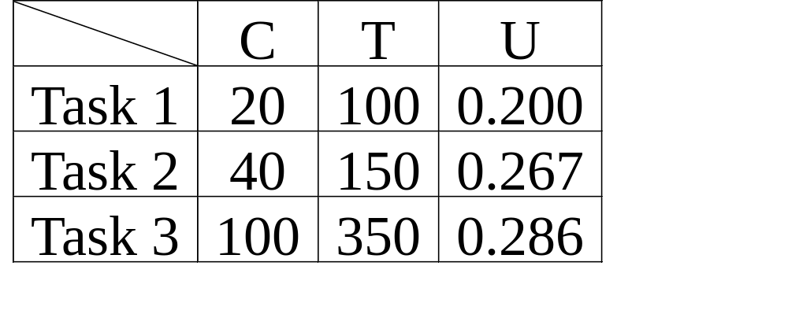
Sample Problem: Applying UB Test
  Total utilization:
    0.200 + 0.267 + 0.286 = 0.753 < U(3) = 0.779
  The periodic tasks in the sample problem are schedulable according to the UB test.

Slide 9
Timeline for Sample Problem
0
100
200
300
400
₁
₂
₃
Scheduling Points
(scheduling point: a point in time when new work arrives
worst-case phasing: all tasks are ready to execute at t=0)

Slide 10
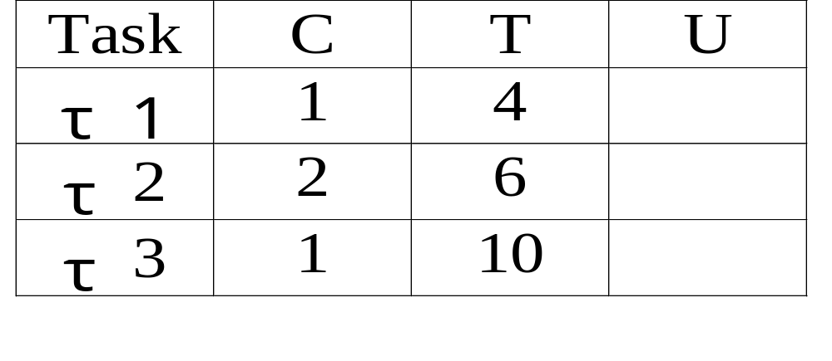
Exercise: Applying the UB Test
  Given:
  a. What is utilization for each task?
  b. Is the task set schedulable?
  c. Draw the timeline.
  d. What is the total utilization if C₃=2?

Slide 11
Extension of UB test
  UB test has three possible outcomes.
    0 ≤ U ≤ U(n) → success
    U(n) < U ≤ 1.00 → inconclusive
    1.00 < U → overloaded
  UB test is conservative
  A more precise test can be applied.

Slide 12
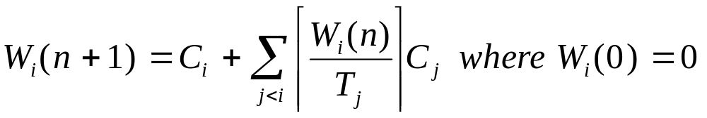
Schedulability: CT Test
  Theorem
    For a set of independent, periodic tasks, if each task meets its first deadline, with worst-case task phasing, the deadline will always be met.
  Completion Time Test
    Let W_{i} = completion time of task i. W_{i} may be computed by the following iterative formula:
    Task i is schedulable if its completion time is before its deadline. That is, W_{i} ≤ T_{i}

Slide 13
Example: Applying CT Test
  Taking the sample problem, we increase the compute time of T₁ from 20 to 40. Is the task set still schedulable?
  Utilization of first two tasks: 0.667 < U(2) = 0.828
    first two tasks are schedulable by utilization bound test
  Utilization of all three tasks: 0.953 > U(3) = 0.779
    utilization bound test is inconclusive
    need to apply completion time test

Slide 14
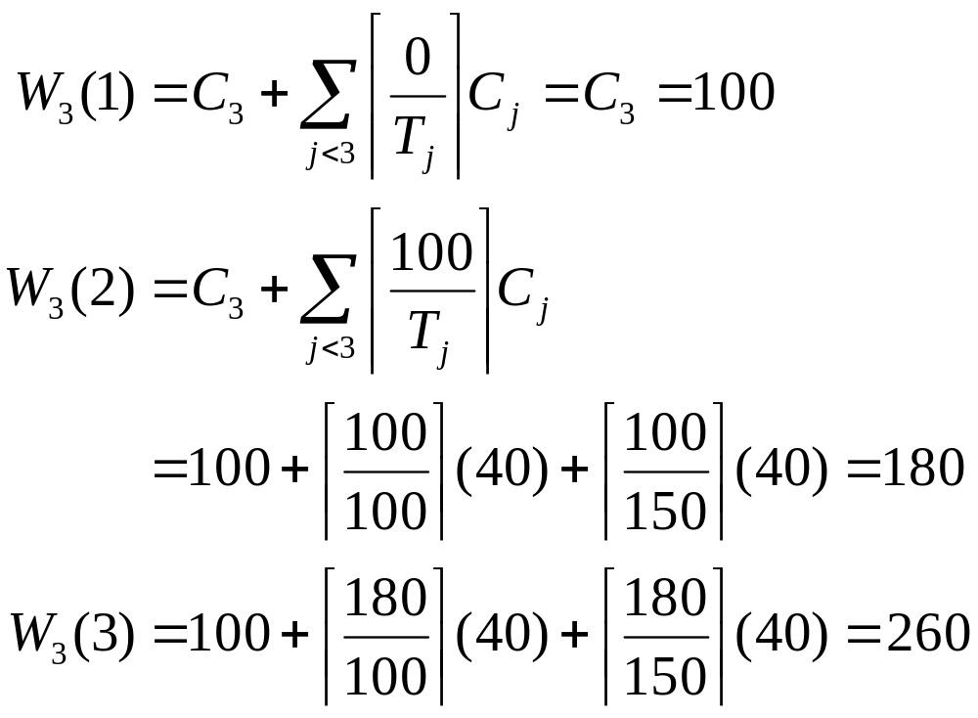
(continued)
  Use CT test to determine if task 3 meets its first deadline

Slide 15
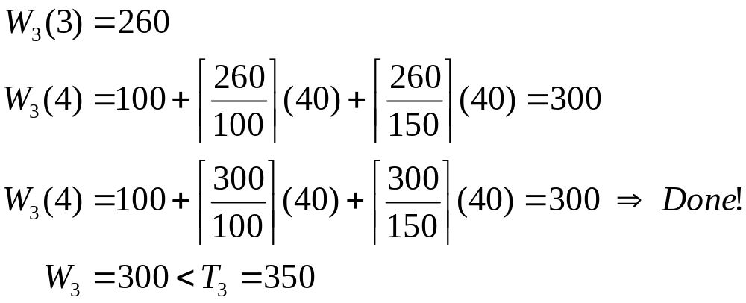
(continued)
Task 3 is schedulable using CT test.

Slide 16
Example : Using Schedulability Points
0
100
200
300
400
₁
₂
₃
Scheduling Points

Slide 17
Exercise: Applying CT Test
  Task τ₁: C₁ = 1 T₁ = 4
  Task τ₂: C₂ = 1 T₂ = 4
  Task τ₃: C₃ = 1 T₃ = 4
  a. Apply UB test.
  b. Draw timeline.
  c. Apply CT test.

Slide 18
Summary
  Utilization bound test is simple but conservative
  Completion time test is more exact but also more complicated
  To this point, UB and CT tests share the same limitations.
    all tasks run on a single processor
    all tasks periodic and noninteracting
    deadlines always at the end of the period
    no interrupts
    rate monotonic priorities assigned
    zero context switch overhead
    tasks do not suspend themselves

Slide 19
Rate Monotonic Analysis(RMA)
Extensions to basic theory
Extending the schedulability tests
  nonzero task switching times
  preperiod deadlines
  priority inversion (blocking)
Task interactions
  synchronization(mutual exclusion) is required

Slide 20
Integrating task switching times and preperiod deadlines
  Task switching time can be modeled as execution time
    for task switching time S, U_{i} = (C_{i}+2S)/T_{i} instead of U_{i} = C_{i}/T_{i}
  Preperiod deadline can be modeled as “dormant time”
    for preperiod deadline D, U_{i} = (C_{i}+D)/T_{i} applied for schedulability test on τ_{i} only
time
T
C
D
T

Slide 21
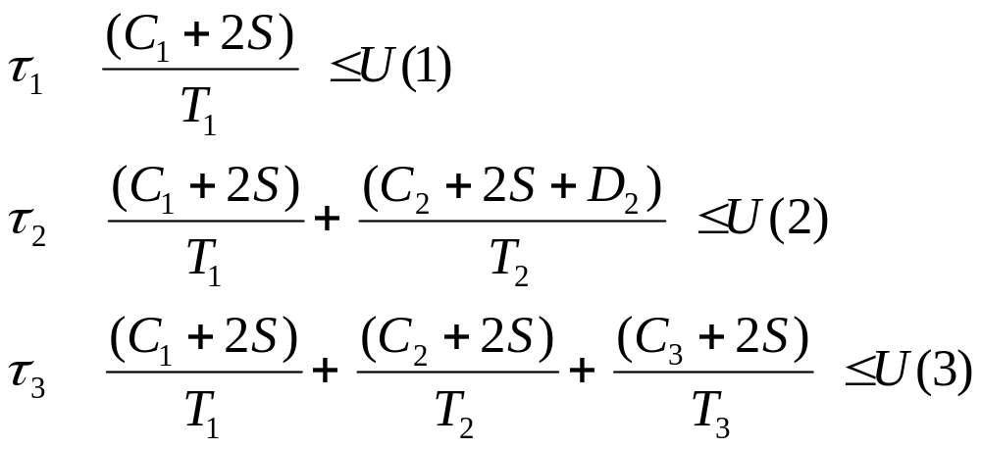
Example for task switching and preperiod deadline
  applying the UB Test to the sample problem

Slide 22
Schedulability with interrupts
  Interrupt processing can be inconsistent with rate monotonic priority assignment
    interrupt handler executes with high priority despite its period
    interrupt processing may delay execution of tasks with higher rate monotonic priority (shorter periods)
  Effects of interrupt processing must be taken into account in schedulability model.
    higher priority tasks regard the interrupt as blocking factor. (source of priority inversion)

Slide 23
Priority inversion
  Delay to a task’s execution caused by interference from lower-priority tasks is known as priority inversion.
  Priority inversion is modeled by blocking time.
  Identifying, modeling and reducing sources of priority inversion is central to schedulability analysis.

Slide 24
Sources of priority inversion
  non-preemptable regions of code
  interrupts
  non-unique priorities for some tasks
  (if there are not enough priority levels)
  non-rate-monotonic assignment of task priorities
  FIFO queues
  synchronization and mutual exclusion

Slide 25
Accounting for priority inversion
  Recall that task schedulability is affected by:
    preemption: potentially many times per period
    execution: once per period
    blocking: at most once per period for each source
  The schedulability formulas are modified to add a “blocking” or “priority inversion” term to account for inversion effects.

Slide 26
Adding blocking time to schedulability test
0 100
₁
For
₁
I
0 100 200
₁
For
₂
₂
I
0 100 200 300 400
₁
₂
Interrupt
For
₄
I
I
₄

Slide 27
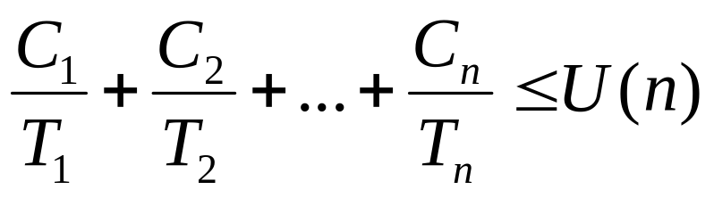
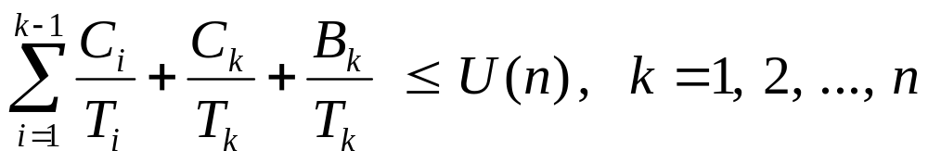
UB test with blocking
  Before considering priority inversion, we simply tested the total utilization for n tasks:
  Now we must test each task for schedulability.
  The general schedulability test is:

Slide 28
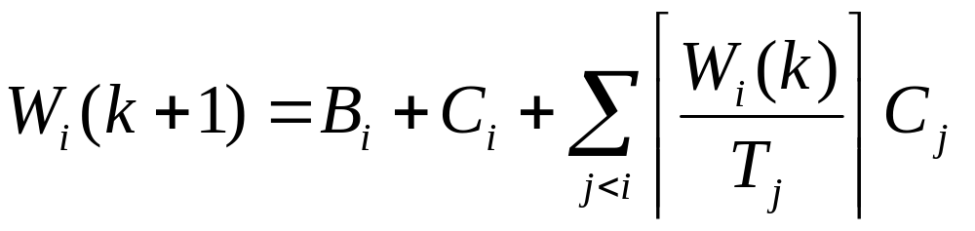
CT test with blocking
  A set of periodic tasks, scheduled according to the rate monotonic policy, is schedulable if each task meets its first deadline.
  That is, if completion time of each task, W_{i}, is less than or equal to its deadline.
blocking execution preemption

Slide 29
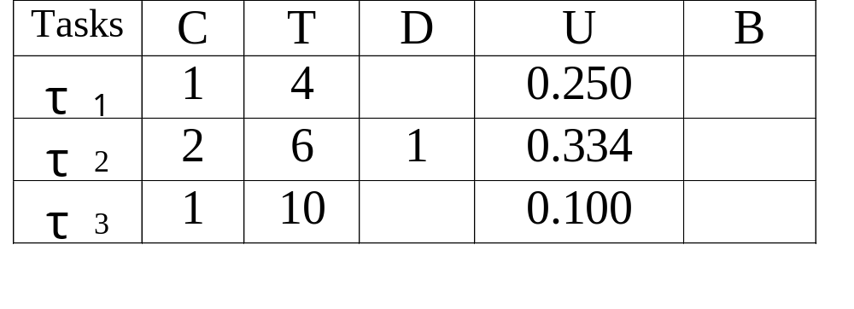
Exercise: Schedulability with priority inversion
  Given: (where τ₃ is nonpreemptive )
  a. fill in column B
  b. construct a schedulability model
  c. which tasks are schedulable?

Slide 30
Synchronization problem
  analyze the effects of task interactions on schedulability
  in this discussion
    synchronization = mutual exclusion

Slide 31
Sample Problem : Synchronization
Periodics
Servers
Aperiodics
100 msec
Emergency
50 msec
₁
20 msec
Data Server
5 msec
2 msec
150 msec
20 msec
Deadline 6 msec
after arrival
₂
40 msec
Comm Server
Routine
40 msec
10 msec
350 msec
10 msec
2 msec
₃
100 msec
Desired response
4 msec average
₂’s deadline is 20 msec before the end of each period.

Slide 32
Synchronization Model
Legend
Critical section
Executing
Blocked
₁:{…P(S)…V(S)…}
₃:{…P(S)…V(S)…}
B
attempts to lock S (blocked)
S locked
S unlocked
τ₁(H)
τ₂(M)
S locked
S unlocked
τ₃(L)
Time

Slide 33
Priority Inversion in Synchronization
Legend
S1 locked
Executing
Blocked
₁:{…P(S1)…V(S1)…}
₃:{…P(S1)…V(S1)…}
attempts to lock S1 (blocked)
S1 locked
S1 unlocked
B
τ₁(H)
B
τ₂(M)
S1 locked
S1 unlocked
τ₃(L)
Time

Slide 34
Synchronization protocols
  no preemption
  highest locker’s priority
  basic priority inheritance
  priority ceiling
  Each protocol prevents unbounded priority inversion

Slide 35
Nonpreemption Protocol
Legend
S1 locked
Executing
Blocked
₂:{…P(S1)…V(S1)…}
₄:{…P(S1)…V(S1)…}
Ready
B
τ₁(H)
B
Ready
τ₂
Ready
τ₃
S1 locked
S1 unlocked
τ₄(L)
Time

Slide 36
Highest Locker’s Priority Protocol
Legend
S1 locked
Executing
Blocked
₂:{…P(S1)…V(S1)…}
₄:{…P(S1)…V(S1)…}
B
τ₁(H)
Ready
τ₂
B
B
Ready
τ₃
S1 locked
S1 unlocked
τ₄(L)
Time

Slide 37
Basic Inheritance Protocol (BIP)
Legend
S1 locked
Executing
Blocked
₂:{…P(S1)…V(S1)…}
₄:{…P(S1)…V(S1)…}
B
τ₁(H)
Attempts to lock S1
S1 locked
S1 unlocked
Ready
τ₂
B
Ready
τ₃
S1 locked
S1 unlocked
τ₄(L)
Time

Slide 38
Priority Ceiling Protocol (PCP)
Legend
S1 locked
Executing
Blocked
₂:{…P(S1)…V(S1)…}
₄:{…P(S1)…V(S1)…}
B
τ₁(H)
Attempts to lock S1
S1 locked
S1 unlocked
Ready
τ₂
B
Ready
τ₃
S1 locked
S1 unlocked
τ₄(L)
Time

Slide 39
Priority ceiling
  priority ceiling of a semaphore S
    simply the priority of the highest priority task that may lock semaphore S
    “system” ceiling: the maximum ceiling of all semaphores currently locked by other tasks
  the idea behind PCP
    to create a total priority ordering of executing and suspended critical sections
τ (high)
S
τ (low)
priority ceiling of semaphore S is the priority of τ (high)

Slide 40
Priority ceililng protocol(PCP) rules
  Preemption: A task with a higher execution priority always preempts tasks with lower execution priorities.
  Ceiling: A task cannot enter its critical section unless its priority is higher than the system ceiling.
  Inheritance: A lower priority task that blocks a higher priority task T_{h} inherits the priority of task T_{h}.
    [When there is only one semaphore, PCP works just like BIP.]

Slide 41
PCP rules - revisited
  1. when T wants to enter the c. s.
    its priority must be higher than system ceiling
    when exiting, wake up the highest priority task among the blocked
  2. while running inside the c. s.
    always inherits highest priority among the blocked
  3. When T does not want to enter the c. s.
    can preempt a lower priority task
  4. when T completes execution normally
    if there are many tasks of same priority ready for execution, schedule the task blocking other tasks

Slide 42
PCP Example
J₀ = { …, P(S₀), …, V(S₀), … }
J₁ = { …, P(S₁), …, P(S₂), …, V(S₂), …, V(S₁), … }
J₂ = { …, P(S₂), …, P(S₁), …, V(S₁), …, V(S₂), … }
Critical section guarded by S₀ S₁ S₂
S₀ locked
S₀ unlocked
J₀
S₂ locked
S₂ unlocked
Blocked by J₂
S₁ locked
S₁ unlocked
(attempt to
lock S₁)
J₁
S₂ locked
S₁ unlocked
S₁ locked
S₂ unlocked
J₂
time
t₀
t₁
t₂
t₃
t₄
t₅
t₆
t₇
t₈
t₉
t₁₀
t₁₁
t₁₂
t₁₃

Slide 43
PCP Example
J₀ = { …, P(S₀), …, V(S₀), …, P(S₁), …, V(S₁), ... }
J₁ = { …, P(S₂), …, V(S₂), … }
J₂ = { …, P(S₂), …, P(S₁), …, V(S₁), …, V(S₂), … }
Critical section guarded by S₀ S₁ S₂
S₀ unlocked
S₁ locked
S₀ locked
S₁ unlocked
J₀
blocked by J₂
(attempt to lock S₀)
S₂ locked
S₂ unlocked
(attempt to lock S₁)
blocked by J₂
J₁
S₂ locked
S₁ locked
S₁ unlocked
S₂ unlocked
J₂
time
t₀
t₁
t₂
t₃
t₄
t₅
t₆
t₇
t₈
t₉
t₁₀
t₁₁
t₁₂
t₁₃
t₁₄

Slide 44
Example Of Chained Blocking (BIP)
₁:{…P(S1)…P(S2)…V(S2)...V(S1)…}
₂:{…P(S1)…V(S1)…}
₃:{…P(S2)…V(S2)…}
Legend
S1 locked
S2 locked
Blocked
B
Attempts to lock S1 (blocked)
Attempts to lock S2 (blocked)
τ₁(H)
B
B
B
S1 locked
S1 unlocked
τ₂(M)
S2 locked
S2 unlocked
τ₃(L)
Time

Slide 45
Blocked At Most Once (PCP)
₁:{…P(S1)…P(S2)…V(S2)...V(S1)…}
₂:{…P(S1)…V(S1)…}
₃:{…P(S2)…V(S2)…}
Legend
S1 locked
S2 locked
Ceiling
S1 locked
S2 unlocked
S1 locked
S1 unlocked
Attempts to lock S1 (blocked)
τ₁(H)
Attempts to lock S1 (blocked)
S1 locked
S1 unlocked
τ₂(M)
S2 locked
S2 unlocked
τ₃(L)
Time

Slide 46
Deadlock: Using BIP
Legend
S1 locked
S2 locked
Blocked
₁:{…P(S1)…P(S2)…V(S2)...V(S1)…}
₂:{…P(S2)…P(S1)…V(S1)...V(S2)…}
B
attempts to lock S2 (blocked)
locks S1
τ₁(H)
B
S2 locked
Attempts to lock S1 (blocked)
τ₂(M)
Time

Slide 47
Deadlock Avoidance: Using PCP
₁:{…P(S1)…P(S2)…V(S2)...V(S1)…}
₂:{…P(S2)…P(S1)…V(S1)...V(S2)…}
Legend
S1 locked
S2 locked
Ceiling
B
locks S2
attempts to lock S1 (blocked)
locks S1
τ₁(H)
locks S2
locks S1
unlocks S1
unlocks S2
τ₂(M)
Time

Slide 48
Summary of synchronization protocols
  No preemption
    do not allow preemption during execution of critical sections
  Highest locker’s priority
    execute critical sections with the priority of the highest priority task that may lock the semaphore
  Priority inheritance
    when a lower priority task blocks the execution of a higher priority task, it inherits the priority of the task it blocks
  Priority ceiling
    priority inheritance plus priority ceiling rule for locking semaphores

Slide 49
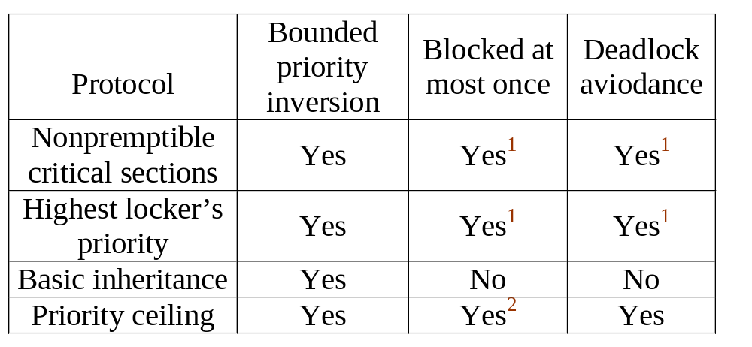
(continued)
Summary of synchronization protocols
1 Only if tasks do not suspend within critical sections
2 PCP is not affected if tasks suspend within critical sections.

Slide 50
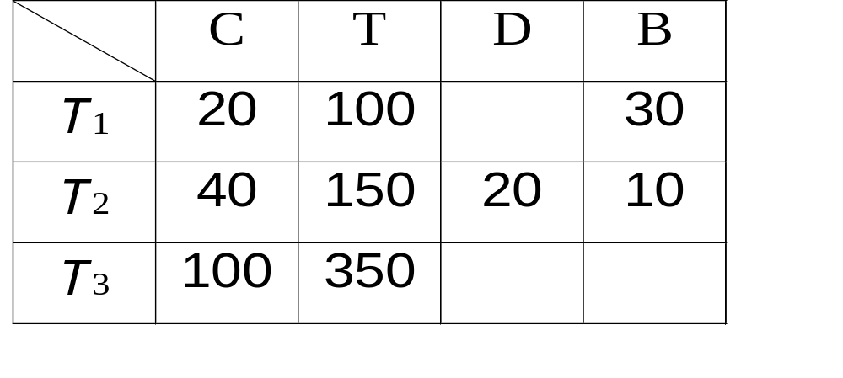
Sample Problem: Using BIP
D: preperiod deadline

Slide 51
Schedulability model using BIP
C₁
⎯⎯
T₁
B₁
⎯⎯
T₁
20
⎯
100
30
⎯
100
+
≤
+
=
U (1)
0.50 < 1.0
C₁
⎯⎯
T₁
C₂ D₂
⎯⎯⎯⎯⎯⎯
T₂
+
B₂
⎯⎯
T₂
+
+
+
≤
20
⎯
100
+
40 20
⎯⎯⎯
150
+
10
⎯
150
=
U (2)
0.667 < 0.828
C₁
⎯⎯
T₁
C₂
⎯⎯
T₂
C₃
⎯⎯
T₃
+
+
≤
U (3)
20
⎯
100
+
40
⎯
150
+
100
⎯
350
=
0.753 < 0.779

